Slide 1
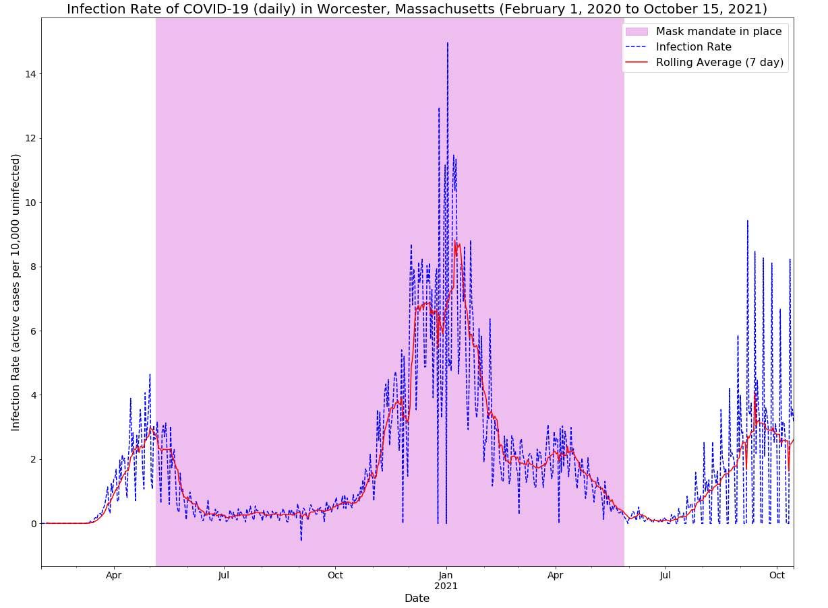

Slide 2




Investigating
prevailing beliefs around weather and illness

Slide 3


Why quantify the role of weather on spread of infectious illness?
Hypothesis: Weather alone cannot explain more than 33% of the variability in spread of covid-19
>

Slide 4

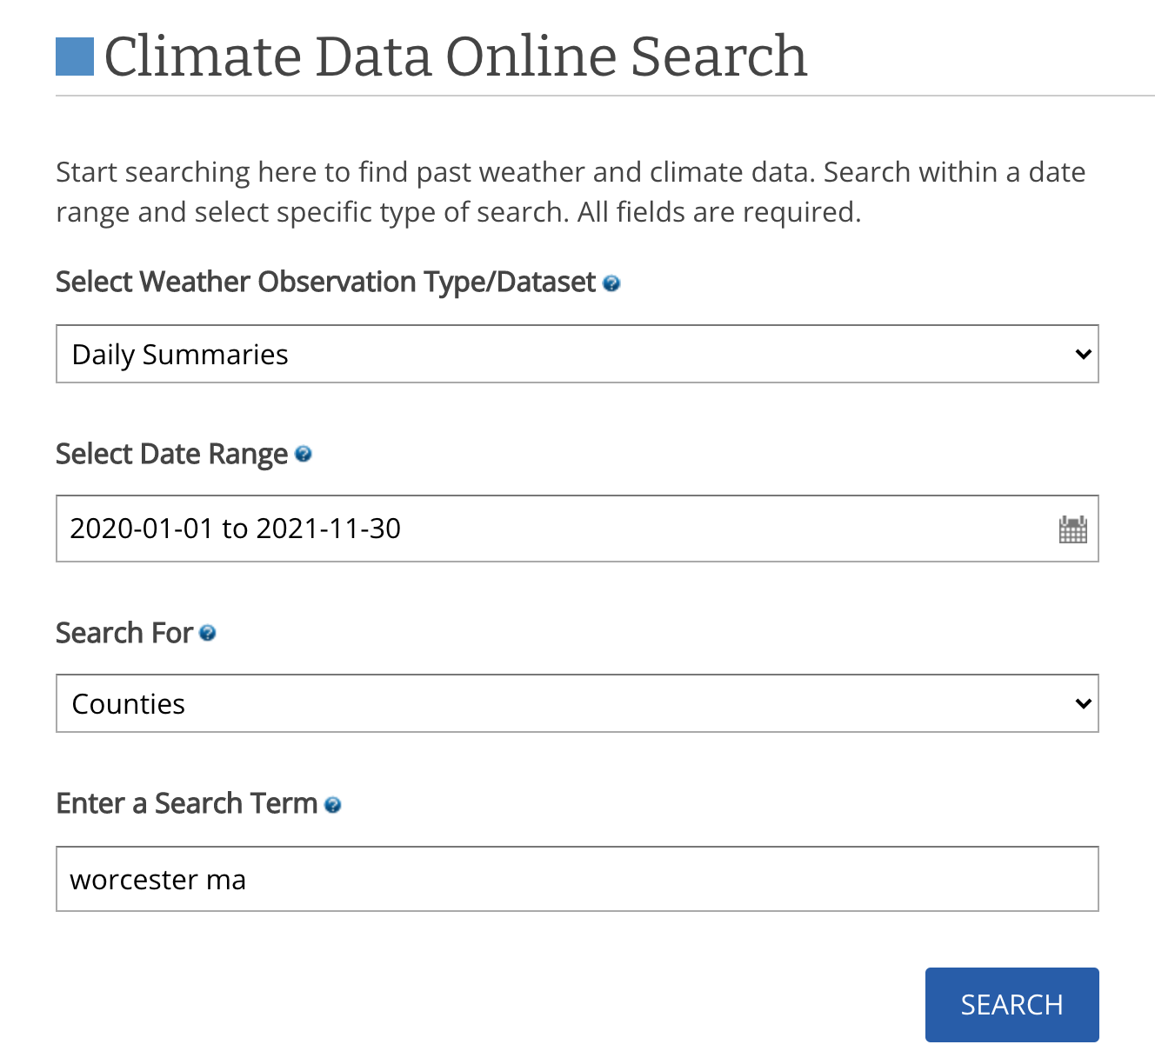
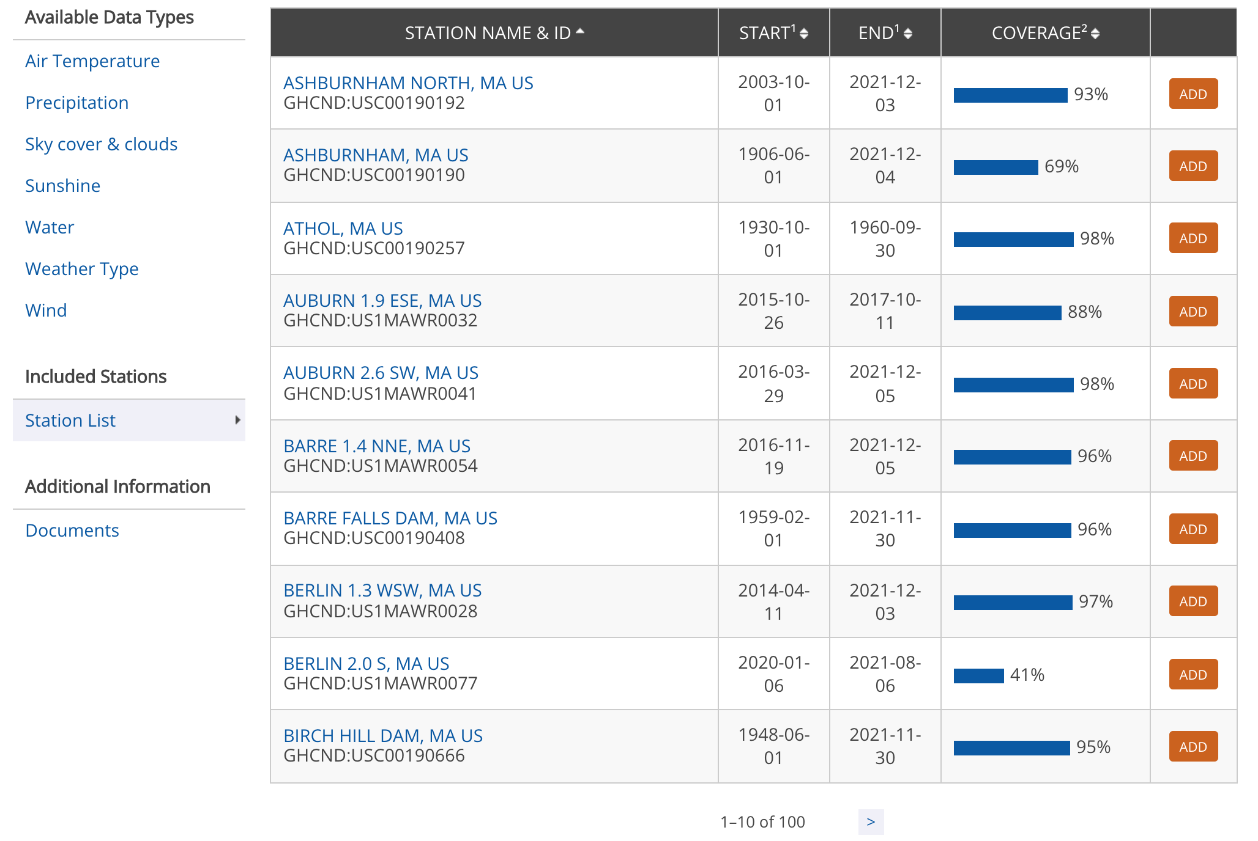
NOAA link for Worcester County, MA: https://www.ncdc.noaa.gov/cdo-web/datasets/GHCND/locations/FIPS:25027/detail

Slide 5
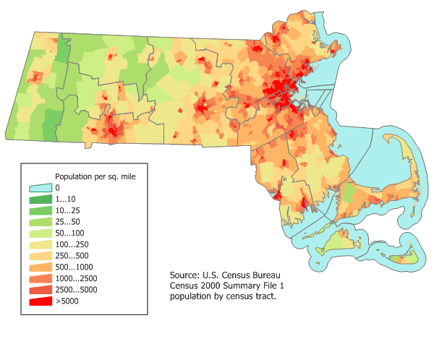
Worcester County, Massachusetts
Weather Station GHCND:USW00094746* outside the city of Worcester, Massachusetts
*Global Historical Climatology Network daily
Map credit to https://www.worldofmaps.net/en/north-america/maps-of-massachusetts-usa/map-of-massachusetts-population-density.htm
GHCND documentation: https://www1.ncdc.noaa.gov/pub/data/cdo/documentation/GHCND_documentation.pdf
Notes:
land surface stations across the globe, subjected to a common suite of quality assurance, more than 100,000 stations 180 countries and territories

Slide 6
Derived Features
Measurements
Average daily wind speed, max wind speeds and directions
Temperature (average, min, and max)
Precipitation
Snowfall
Fog, smoke, haze
Thunder
“Rime”, i.e. when ice coats surfaces such as tree branches
Season
Average relative humidity
Average temperature (rolling 7 day)
Change in average temp week to week
Average precipitation (rolling 7 day)
Average snowfall (rolling 7 day)
Total precip (rolling 7 day)
Total snowfall (rolling 7 day)
Change in temperature daily

Slide 7
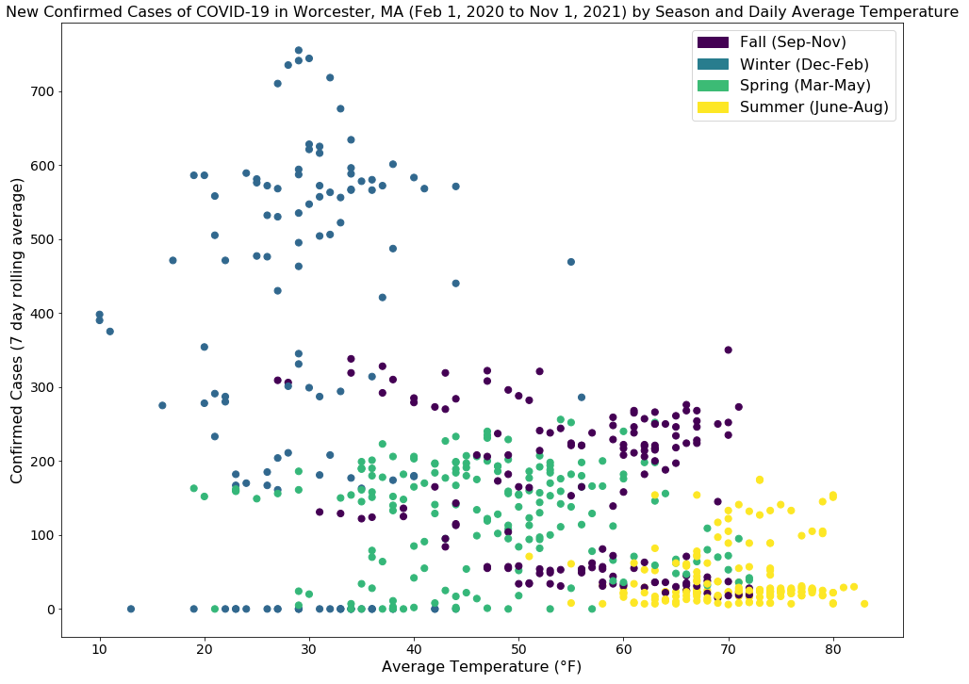

Slide 8
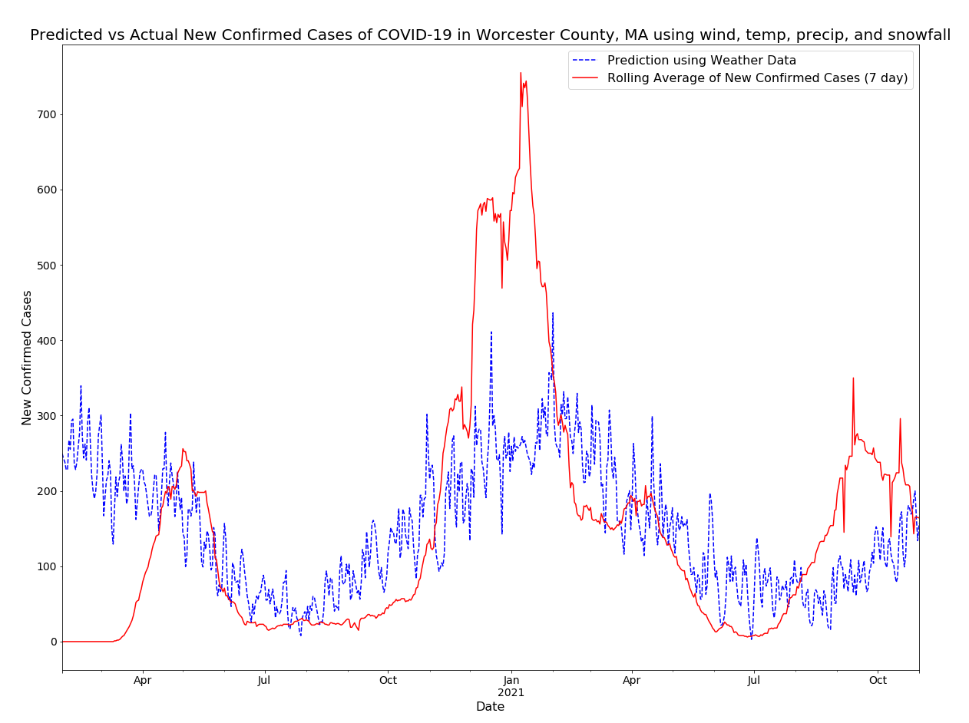
Multivariate Linear Regression using daily weather predictors: average wind speed (mph), precipitation (in), snowfall (in), average temperature (°F)
R² = 0.2668
Intercept = 399.67 cases
Coefficients =
+0.26 per additional mph of average wind speed
+1.22 per additional inch precipitation
+9.26 per additional inch snowfall
-4.81 per average degree F of average temperature
Only temperature statistically significant

Slide 9
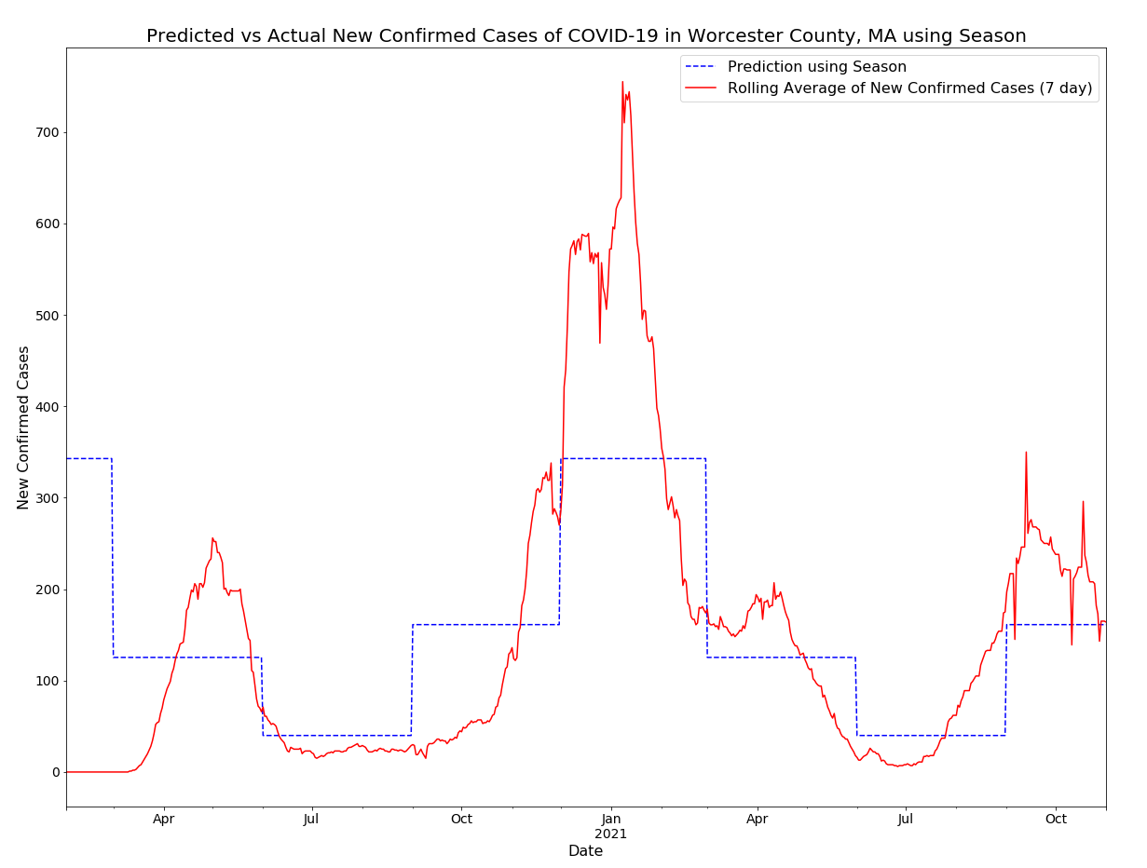
Multivariate Linear Regression using one hot encoding of seasons as predictors: isFall, isWinter, isSpring
R² = 0.407
Intercept = 39.96 cases (corresponds to summer)
Coefficients =
+121.24 cases in Fall = 161.2 cases
+302.83 in Winter =
342.79 cases
+85.39 in Spring =
125.35 cases
All variables statistically significant with p = 0

Slide 10
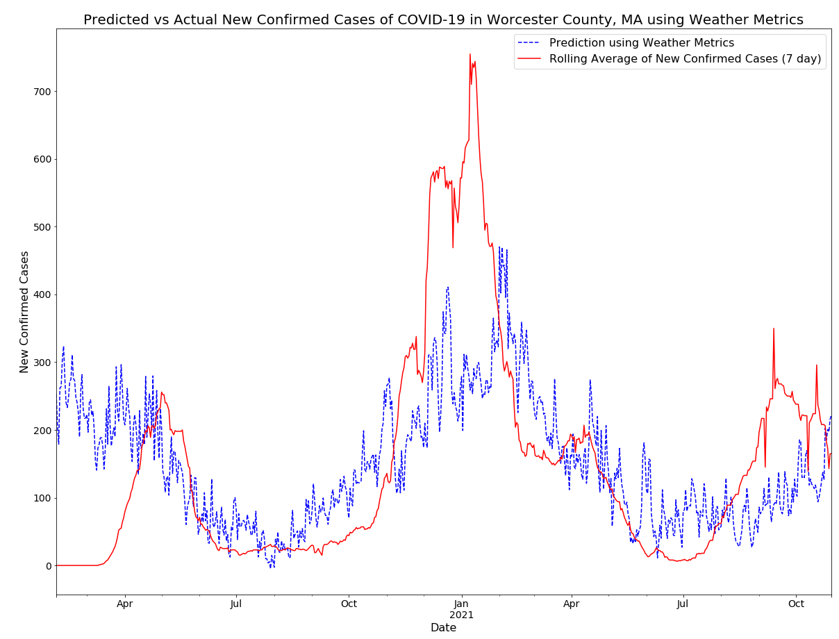
Multivariate Linear Regression using derived weather metrics as predictors: Glaze or rime, Avg relative humidity, AvgTempWeek, ChangeInAverageTempWeek, AvgPrecipWeek, AvgSnowWeek, ChangeInTempDay, TotalPrecipWeek, TotalSnowfallWeek
R² = 0.329
Intercept = 390.87 cases
Coefficients* =
-86.09 cases when ‘Glaze or Rime’
+0.92 cases per additional 1% humidity
-5.00 case per additional degree average weekly temp
+49.46 per additional inch average weekly snow
-2.79 per additional degree of change in temp daily
* Only showing statistically significant variables p < 0.05

Slide 11
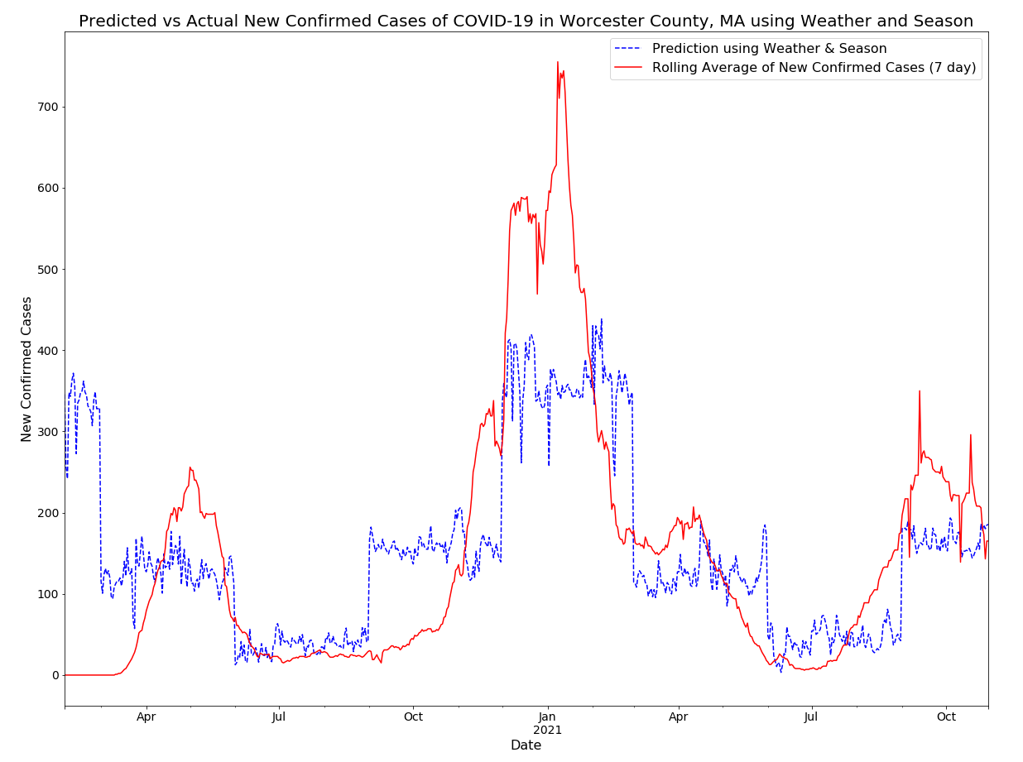
Multivariate Linear Regression using derived weather metrics and one hot encoding of seasons as predictors.
R² = 0.452
Intercept = 10.16 cases (corresponds to summer)
Coefficients* =
-104.9523 cases when ‘Glaze or Rime’
+28.67 cases per inch of average snowfall in the week
+118.86 cases in Fall
+318.08 cases in Winter
+103.36 in Spring
* Only showing statistically significant variables p < 0.05

Slide 12



